Slide 1
COP2268 – Java Programming
Week 2 Assignments
Anastasia Rashtchian
anastasia.rashtchian@rasmussen.edu
(773) 979-2830 (CST)

Slide 2
Week 2 Objectives
By the end of this module you should be able to:
Evaluate objects and classes.
Describe inheritance.
Formulate the implementation of polymorphism.
Describe the importance of an array.

Slide 3
Readings
Java: A Beginner’s Tutorial - Chapters 4 through 7 and 11
Activity Time: 8 hours
Chapter 4: Object and Classes
Chapter 5: Core Classes
Chapter 6: Arrays
Chapter 7: Inheritance
Chapter 11: Polymorphism

Slide 4
Week 2 Discussion Question
You are working as the software developer and planning to use the object-oriented concepts in programming.
Your teammates are often confused with method overloading and method overriding.
You need to answer the following question and clarify for your teammates.

Slide 5
Week 2 Discussion Question
Your answers are to be well thought out, scholarly paragraphs that answer each question.
Describe the main difference between method overloading vs. method overriding.
Give at least one example of method overloading.
Give at least one example of method overriding.
Please feel free to write and execute a program to illustrate your information for the benefit of the class.

Slide 6
Reply Post
In your response to your classmate(s), include any tips you may have learned along the way that might be helpful in getting them to understand the difference between method overloading vs. method overriding.
Do you agree or disagree with their post?
Does it logically make sense to you?
If not, why and what can they do to make it clear so that anyone could understand the process?

Slide 7
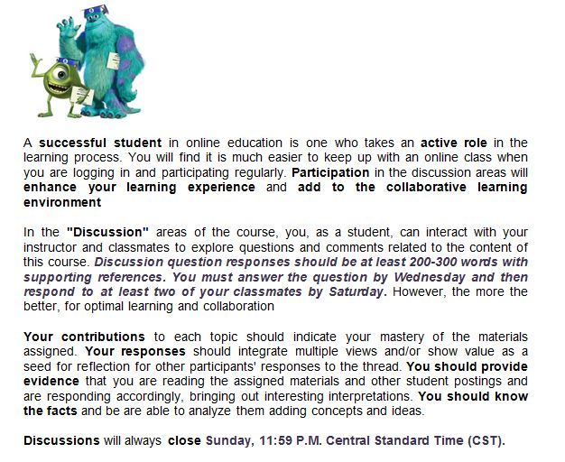
Discussion Questions All Weeks

Slide 8
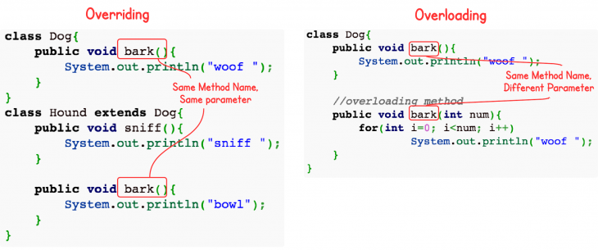
Overring vs Overloading

Slide 9
Overring vs Overloading
Overloading occurs when two or more methods in one class have the same method name but different parameters.
Overriding means having two methods with the same method name and parameters.
One of the methods is in the parent class and the other is in the child class.
Overriding allows a child class to provide a specific implementation of a method that is already provided its parent class.

Slide 10
Week 2 Assignment
You are working as the software developer and need to solve the problem using the inheritance concept.
Your goal is to create the method to sort the numbers and then perform the addition.

Slide 11
Week 2 Assignment
Step 1:
Create the base class that has the sorting method.
The sorting method should take the input parameter as the array and print the sorted array.

Slide 12

Week 2 Assignment
Step 2:
Create the child class that inherits all the methods from the above base class.
The child class has the addnumber method that adds all the numbers from an array.
The addnumber method first calls the base class sorting method to sort all the array numbers.
Once the numbers in the array are sorted, then addnumber method adds all of them.

Slide 13
Week 2 Assignment
Your submission should include the following:
Base Class
Child Class
Entire Java Solution
Output screenshot created in Microsoft Word

Slide 14
Week 2 Assignment
You must submit
The java source code copied into a Word Document
Screenshot(s) of your output screen copy/pasted into the same Word Document
(Please do not give me .java or project files)

Slide 15
Module 02 Assignment - Inheritance
Criteria | Points
Created a Base Class. | 25
Created a Child Class. | 25
Submitted an entire Java solution. | 25
Submitted an output screenshot created in Microsoft Word. | 25
Total | 100

Slide 16
Week 2 Course Project
You are working as a software developer for a large insurance company. Your company is planning to migrate the existing systems from Visual Basic to Java and this will require new calculations. You will be creating a program that calculates the insurance payment category based on the BMI score.

Slide 17
Week 2 Course Project
Your Java program should perform the following things:
Take the input from the user about the patient name, weight, birthdate, and height.
Calculate Body Mass Index.

Slide 18
Week 2 Course Project
Display person name and BMI Category.
If the BMI Score is less than 18.5, then underweight.
If the BMI Score is between 18.5-24.9, then Normal.
If the BMI score is between 25 to 29.9, then Overweight.
If the BMI score is greater than 29.9, then Obesity.

Slide 19
Week 2 Course Project
Calculate Insurance Payment Category based on BMI Category.
If underweight, then insurance payment category is low.
If Normal weight, then insurance payment category is low.
If Overweight, then insurance payment category is high.
If Obesity, then insurance payment category is highest.

Slide 20
Week 2 Course Project – Calculate Insurance Category
Criteria | Points
Submitted an entire Java solution. | 50
Submitted an output screenshot created in Microsoft Word. | 50
Total | 100

Slide 21


Anastasia Rashtchian (MSCS, EdM, CAF, QEP, Citi Certified)
Email: anastasia.rashtchian@rasmussen.edu
Phone: (773) 979-2830 (9am-7pm CST)
Office Hours: Mondays 2pm-3pm
Live Lectures: Every Monday at 3pm CST
LinkedIn: https://www.linkedin.com/pub/anastasia-jakubow/10/a62/906

